Slide 1
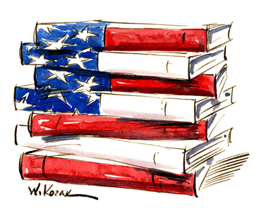
History of American Literature
From storytelling to stateliness
Chapters 1-9
Years: 1200-1806
Alyssa Holcomb
Per. 1 AP USH
2010

Slide 2
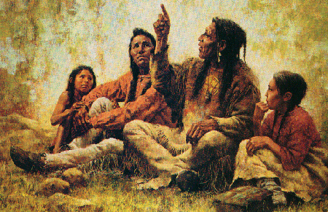
Chapters 1-3 Information
Chapter 1: Storytelling
-told through objects like pottery and such
-this is common for many first groups because the stories may have been told orally, but the earliest forms of recording were on objects like pottery (which they used often…also seen in Greco-Roman history)

Slide 3
Chapters 1-3 Information
Chapter 2: Oral Tellings and Paintings of the Native Americans
-Europeans during the Renaissance were increasingly moving upward in forms of literature:
-particularly based off of religion, similarly to the somewhat religious native tellings (Reformation for Euros?)
-as far as writing goes, some explorers like Columbus kept logs (albeit falsified logs) tracking their explorations; their writing was published to the European public and sent them into a tizzy over exploring new lands and such
-English turn towards colonization: Thomas Harriot’s “Briefe and True Report of the Newfound Land of Virginia” in 1588:
-“addressed mainly to the problem of identifying the ‘merchantable commodities’ that would support settlement, for without products a colonial system was impossible”
-later publications of this book showed engravings based on John White (partner)’s watercolors of people/landscape of VA

Slide 4
Chapters 1-3 Information
Chapter 3: Early Colonial Times
The foundation of American literature begins with the orally transmitted myths, legends, tales, and lyrics (always songs) of Indian cultures. Native American oral tradition is quite diverse. Indian stories glow with reverence for nature as a spiritual, as well as physical, mother. Nature is alive and endowed with spiritual forces; main characters may be animals or plants, often totems associated with a tribe, group, or individual.
The Indian contribution to America is greater than is often believed. The hundreds of Indian words in everyday American English include: canoe, tobacco, potato, moccasin, moose, persimmon, raccoon, tomahawk, totem
Glorious Revolution:
In English history, the events of 1688 – 89 that resulted in the deposition of James II and the accession of his daughter Mary II and her husband William III. James's overt Roman Catholicism, his suspension of the legal rights of dissenters, and the prospect of a Catholic heir to the throne brought discontent to a head, which caused opposition leaders to invite the Protestant William of Orange to bring an army to redress the nation's grievances. The support remaining for James dwindled, and he fled to France. The Convention Parliament asked William and Mary to rule jointly and set out the Bill of Rights.

Slide 5
Chapters 1-3 Information
Chapter 3: Early Colonial Times
April 30, 1686 James dismisses four more judges.
May 2/April 22 The Privy Council orders the common
hangman to burn publicly a copy of Jean Claude’s “Les Plaintes de Protestants cruellement opprimes dans la Royaume de France”.
Relationships:
Two Poems, 1678 (Anne Bradstreet, “Poems of Mrs. Anne Bradstreet” → Boston, 1758):
To My Dear and Loving Husband
Before the Birth of One of Her Children
-shows the rare love that was so stressed in the Plymouth society by the Courts
The Duty of Children Towards Their Parents, 1727 (Paul Leicester Ford, “The New England Primer” → New York, 1899).
Good Manners for Colonial Children, 1772 (Eleazer Moody, “The School of Good Manners. Composed for the Help of Parents in Teaching Their Children How to Carry It in Their Places During Their Minority” → Boston: Fleets, 1772)
-children were expected to obey parents, and this mentality was forced onto them
-reinforces “first impression” rule (embarrassment on parents = embarrassment on society)

Slide 6
Chapters 4-6 Information
Chapter 4:
Olaudah Equiano: “The Interesting Narrative of the Life of Olaudah Equiano”
-published in 1789 → numerous editions, several languages → “became prototype for dozens of other slave narratives in 19th century”
-background: captured in Nigeria in 1756 at 11 years old → transported to America and purchased by English sea captain
-eventually succeeded after 10 years by buying his own freedom and “dedicating himself to the anti-slavery cause”
Slaves being sold told of their tales:
-“shock” of being sold/shipped into slavery → wrote songs about their experiences and “implored their god(s)” to assist them → “published by abolitionists in the 19th century”
John Woolman: “Considerations on the Keeping of Negroes”
-published in 1754 → “pointed to the Bible’s declaration that all peoples were of one blood” → “urged readers to imagine themselves in the place of the African people” → this “anti-slavery” movement didn’t become widespread until the Revolution

Slide 7
Chapters 4-6 Information
Chapter 5:
Roger Williams: “The Bloudy Tenet of Persecution”
-published in 1644 → “one of the first formal arguments for religious toleration”→ “New Englander…leader of dissenting Rhode Island”
-wrote that “forced worship…stinks in God’s nostrils”
-gained appeal following the English civil war’s religious excesses
-lamented “sad experience” of previous generations’ religious conflicts
John Locke: “Letter on Tolerance”
-continued Williams’ thoughts (“new climate of opinion”)
-published 1688
-argued “churches were voluntary societies and could work only through persuasion”
-his beliefs became “embodied” in the Toleration Act that was passed by Parliament in 1689 → at first resisted by New England, but after pressure from the English authority, Massachusetts and Connecticut “reluctantly allowed other Protestant denominations to begin worshipping openly in 1700”
Thomas Malthus → population growth thoughts in the 18th century
-described population growth in the 1700’s as “a rapidity of increase probably without parallel in history”

Slide 8
Chapters 4-6 Information
Chapter 5:
Mary Rowlandson: “Sovereignty and Goodness of God”
-published 1682 → first narrative publication during the Enlightenment
-(this narrative genre was second in popularity behind the Bible in the colonial era)
-tells the story of her captivity among Indians in King Philip’s War → “pilgrim’s progress through the American wilderness”
-“stimulated 500 other narratives”
Reverend John Williams: “Redeemed Captive”
-one of Rowlandson’s “stimulated” books → less religion and more gore than his predecessor’s
Benjamin Franklin: “Poor Richard’s Almanac”
-published 1732-57 → made most important out of all of the others by its traditional literary form that was used to “promote the new Enlightenment emphasis on useful and practical knowledge”
-showed Franklin as a “poor bumpkin” named “Poor Richard” → “one of the first Americans to bring Enlightenment thought to ordinary folk”
Novels sold during the Enlightenment era during this period
-included the works of Shakespeare, John Milton, Joseph Addison’s essays, Richard Steele, Jonathan Swift, Samuel Johnson, etc.
-also included novels like Daniel Defoe’s “Moll Flanders” and Henry Fielding’s “Tom Jones”

Slide 9
Chapters 4-6 Information
Chapter 6:
Daniel Dulany: “Considerations on the Propriety of Imposing Taxes”
-published in 1765 → part of the Stamp Act Crisis
-Maryland lawyer who rejected the theory that the colonists “were represented in Parliament in the same manner as those inhabitants of Britain are who have not voices in elections”, or, as the British argued, “subject to the acts of Parliament by the fact of ‘virtual representation’”
John Dickinson: “Letters from a Farmer in Pennsylvania”
-Philadelphia lawyer who posed as a “humble handsman”→ “most influential response” to the Revenue acts → series of articles reprinted in every colonial newspaper
-argued that “Parliament had the right to regulate trade through the use of duties” & “it could place prohibitive tariffs on foreign products”, but there was “no constitutional authority to tax goods in order to raise revenues in America”
-wanted to “render those in charge of administering colonial affairs independent of elected representatives in colonial assemblies”
Poets in the early political boycott group like “Daughters of Liberty”
Ex: Milcah Martha Moore urging American women to “stand firmly resolved…that rather than freedom we part with our tea” → part of Boston Tea Party (Tea Act rebellion and such, etc.)

Slide 10
Chapters 4-6 Information
Chapter 6:
Massachusetts Circular Letter
-started in February 1768 after Massachusetts House of Representatives approved Samuel Adams’ letter addressed to speakers of other assemblies → made it a “propaganda device”
-denounced Townshead Acts:
-“attacked” British plan to make royal officials independent of colonial assemblies, instead urging them to find a way to “harmonize with each other”
Thomas Paine: “Common Sense”
-published 1776 (pamphlet) → “proposed…simple fact, plain argument, common sense” on crisis concerning Congress trying to take their independence from foreign powers → “single most important piece of writing during Revolutionary era” → sold 100,000+ copies in months

Slide 11
Chapters 7-9 Information
Chapter 7:
The Articles of Confederation
-written following the Continental Congress’ Declaration of Independence
-written November 1777 → “formally adopted by the Continental Congress and
sent to the states for ratification”
-ratification required the agreement of all 13 states → Maryland held this up for three years (wanted Congress to have the states’ ‘Western claims’)
-created the national assembly (Congress) → states had a single vote
-delegates selected annually (determined by state legislatures, subject to term limits → no more than 3 years served in any 6 year period)
-president elected annually → votes decided by “simple majority of the states”
-“major questions” in this voting “would require the agreement of 9 states”
Excerpt:
“Each state retains its sovereignty, freedom, and independence, and every power, jurisdiction, and right, which is not by this Confederation expressly delegated to the United States, in Congress assembled.”

Slide 12
Chapters 7-9 Information
Chapter 7:
“The People the Best Governors” Anonymous.
-published in 1776 as an “early post-Revolution debate”
-“focused on the appropriate governmental structure for the new states”
-no property qualifications for either voting or holding office
-governor should simply execute the people’s wishes that are voiced by
the representatives in the assembly; judges “popularly elected”
-ideal form of government: “community or town meeting, in which the people set their own tax rates, create a militia, controlled their own schools and churches, and regulated the local economy”
-state gov’t., therefore, would needed only for “coordination among communities”
-basic conclusion for the people: “best know their wants and necessities, and therefore are best able to govern themselves”
*All of these ideas were later used in the constitutions of Pennsylvania, Maryland, and New York → “typified the political range of the times”
African-American writers during the Revolutionary Era:
-“Address to the Negroes of the State of New York” Jupiter Hammon.
-published in 1787 → poems and essays (contemporary issues)
-“Poems on Various Subjects, Religious and Moral” Phillis Wheatley (-Ex: “On Being Brought from Africa to America”)
-published in 1773 (London, while she remained a slave in Boston) → *most famous African- American writer of that time; kidnapped and converted to Christianity in the Great Awakening → wrote poems “that combined her piety with a concern for her people”

Slide 13
Chapters 7-9 Information
Chapter 8:
“The Federalist” James Madison, Alexander Hamilton, John Jay
-written in 1787-8 to defend the Constitution
-“Madison stood Montesquieu (Enlightened thinker)’s assumption on its head”
-“the most common and durable source of factions has been the various and unequal distribution of property” → the best way to control this was to “extend” the governmental “sphere”
-“you take in a greater variety of parties and interests; you make it less probable that a majority of the whole will have a common motive to invade the rights of other citizens…”
-basic description: “argued…great size is an advantage → interests are so diverse that no single faction is able to gain control of the state, threatening the freedoms of others”
-became one of the first of the American “parties” (along with Democratic Republican Party)
“The Liberty of the Press” → steady publication of newspapers:
-in 1775, there were 37 weekly or semi-weekly newspapers → increased to 92 by 1789 (includes 8 dailies and 3 papers published west of the Appalachians
-more newspapers in the US than in any other place in the world
-90% of New England population was literate → 2/3 of males reading Pittsburgh Gazette were literate
-“press became principal medium of Federalist and Democratic Republican opinion” → papers became identified by their politics
-Federalist Gazette of the United States (John Fennon and Alexander Hamilton) in 1789
-competing: National Gazette (Philip Freneau, encouraged by Jefferson) in 1791
-“An Essay on Liberty of the Press” George Hay (VA lawyer) in 1799
-synopsis: men should say what they want to based on their passions and opinions, and if they didn’t, the First Amendment would mean nothing

Slide 14
Chapters 7-9 Information
Chapter 8:
“The Liberty of the Press” → steady publication of newspapers
-in 1775, there were 37 weekly or semi-weekly newspapers → increased to 92 by 1789 (includes 8 dailies and 3 papers published west of the Appalachians
-more newspapers in the US than in any other place in the world
-90% of New England population was literate → 2/3 of males reading Pittsburgh Gazette were literate
-“press became principal medium of Federalist and Democratic Republican opinion” → papers became identified by their politics
-Federalist Gazette of the United States (John Fennon and Alexander Hamilton) in 1789
-competing: National Gazette (Philip Freneau, encouraged by Jefferson) in 1791
-“An Essay on Liberty of the Press” George Hay (VA lawyer) in 1799
-synopsis: men should say what they want to based on their passions and opinions, and if they didn’t, the First Amendment would mean nothing

Slide 15
Chapters 7-9 Information
Chapter 8:
“The Birth of American Literature” → examples and brief synopses
-propogandistic drama(s)/nationalist epic(s)
-The Vision of Columbus (Joel Barlow, 1787)
-M’Fingal (John Trumbull, 1782) → “mock epic satirizing the British”
-“considered best-selling fictional work of the war”
Thomas Paine:
-Common Sense (1776)
-pamphlets The American Crisis (1776-83) → “These are the times that try men’s souls,”
-The Rights of Man (1791) → defense of French Revolution
-The Age of Reason (1795) → attack on organized religion (loved by Jeffersonians and loathed by Federalists)
-written from jail cell after banished from Britain for radical political expression
-Michel-Guillaume Jean de Crevecoeur: Letters from an American Farmer (1782) → America was product of many cultures and was a “new man” with new ideas to the world
John Filson:
-Discovery, Settlement, and Present State of Kentucke (1784) → narrative of Daniel Boone as representative of this “new man”
-Hugh Henry Brackenridge (Pittsburgh Gazette editor): Modern Chivalry (1792) → satire including incidents like the Whiskey Rebellion

Slide 16
Chapters 7-9 Information
Chapter 8 (“Birth of American Literature” Continued):
Noah Webster:
-American Spelling Book (1783) → “Blue-Backed Speller” w/ 200,000 copies annually → largest-selling of all American books (best-selling book of the era)
-American Dictionary of the English Language (1828) → argued that the “republican principles” of the language should be used over “aristocratic standards” of “King’s English”
-Mercy Otis Warren (Democratic Republican): History of the Rise, Progress, and Termination of the American Revolution (1805) → delayed publication until after Jefferson’s term ended in 1800 so as not to endure Federalist criticism
Mason Weems: Life of Washington (1800, enlarged 1806) → most popular history of Revolution (popular yet fabricated anecdotes, like the cherry tree story)
Susanna Haswell Rowson: CharlotteTemple (1791) → seduction and abandonment → print for over a century
William Hill Brown: The Power of Sympathy (1789) → first American novel
Charles Brockden Brown and Hannah Webster Foster: gothic novels Arthur Mervyn (1799) and The Coquette (1791)
-first dramatized appearance of women writers and readers

Slide 17
Chapters 7-9 Information
Chapter 9:
Thomas Malthus: Essay on the Principle of Population (1798)
-warned “of an impending population explosion” and “predicted that the British population would soon outstrip the country’s food supply” → warned that it would spread to America
-Jefferson wasn’t worried and said that “the Malthusian prediction need not trouble the United States as long as the country kept expanding”

Slide 18
Terms Chapters 1-3
- totem: spiritual guiding object used by the Native Americans as “guides” for their stories
- English sonnet: sonnet consisting three quatrains and a concluding couplet in iambic pentameter with a specific rhyme pattern
- iambic pentameter: “a common meter in poetry consisting of an unrhymed line with five feet or accents, each foot containing an unaccented syllable and an accented syllable” commonly used by Shakespeare
- rhyme scheme in English sonnet (letter pattern): abab cdcd efef gg
- Gothic: style of literature that applied to European literature, art and architecture during the Renaissance

Slide 19
Terms Chapters 4-6
-almanac: series of collections that show a fuller, more developed sense of opinion on a situation
Ex: Benjamin Franklin’s “Poor Richard’s Almanac” that emphasized Enlightenment thought
-narrative: story-esque type of sharing while still including opinions and thoughts in certain situations
Ex: Mary Rowlandson’s “Sovereignty and Goodness of God” (catalyst in series of stories that shared opinions on various political situations while still telling a story → specifically in this story, she shared her experience of being kidnapped/living with the Indians and her religious thoughts on it)
-newsletter/article series: repeated printing of articles that were seen by the public in an effort to learn more facts and thoughts about political crises in the colonial era
Ex: Massachusetts Circular Letter (series that was started as a “propaganda device” that would be used by the public to hear the latest thoughts on the Townshead Act, etc.
-letter: personal thoughts on what should be done about a certain situation (made public and sent out to publications and important leaders in the community)
Ex: John Locke’s “Letter on Tolerance” in 1688 (expressed views on religious toleration)
-poetry: more “flowing” version of expressing views on various political situations during this colonial era → can use a rhyme scheme, stanza pattern, etc.
Ex: Milcah Martha Moore in Daughters of Liberty → used poetry as an expression of their views on the Tea Act (rebellion)

Slide 20
Terms Chapters 7-9
-newspaper – a popular form of free press that began to circulate more periodically beginning in the Revolutionary Era → was used as a forum for both political parties (Federalists and Democratic Republicans) to voice their propaganda and opinions → therefore, these newspapers would be affiliated with separate parties
-novel – frequented throughout the Revolutionary Era as a more prolonged way of voicing opinions and/or sharing fictional accounts
Ex: “Common Sense” by Thomas Paine (non-fiction) and “Charlotte Temple” by Susanna Haswell Rowson (fiction)
-anecdote – a short account within a novel or story that retells an event in someone’s life; in the Revolutionary Era, the popular “Life of Washington” by Parson Weems portrayed a(n) (false) anecdote about George Washington and a cherry tree → this resulted in falsification of character on Washington’s part that has continued to be told throughout history
-satirical epic – used in the Revolutionary Era as a way to express opinions through older versions of storytelling
Ex: M’Fingal (John Trumbull, 1782) → “mock epic satirizing the British”
-article(s) – used as a guideline in the Revolutionary Era and its rules, as well as a forum in the circulating newspapers
Ex: Articles of Confederation → continued the outlining of American gov’t. & articles in a newspaper (random usage throughout states to express opinions)

Slide 21
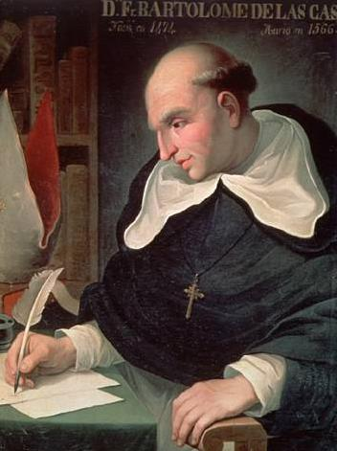
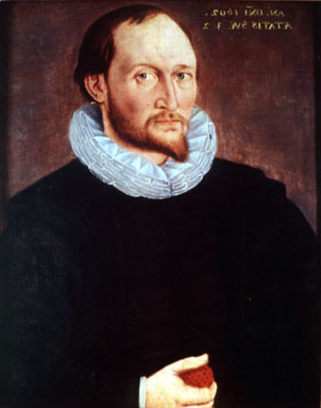
Two Highlighted Figures
Ch. 1-3
Thomas Harriot
“Briefe and True Report of the Newfound Land of Virginia” in 1588:
-“addressed mainly to the problem of identifying the ‘merchantable commodities’ that would support settlement, for without products a colonial system was impossible”
-later publications of this book showed engravings based on John White (partner)’s watercolors of people/landscape of VA
Bartolome de las Casas
“The Destruction of the Indies” in 1552:
-history of the conquest when the Christians tried to take over the Indies (and basically destroyed it)
-assumed that the population losses were at a high → millions
-later thought of otherwise (scholars thought numbers were false → always fluctuating)
-“Black Legend” of Spanish conquest → at a time was used by other Europeans to “condemn Spain as an effort to cover up their own dismal colonial records”

Slide 22
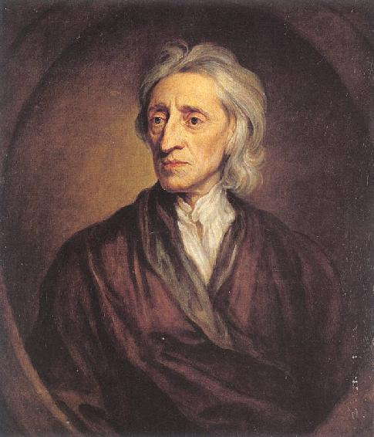
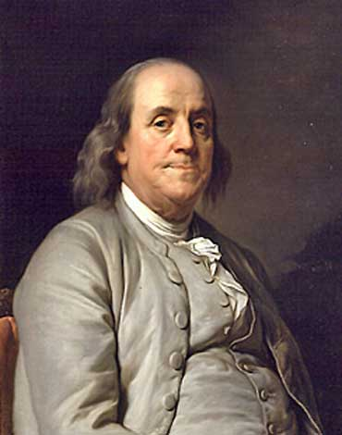
Two Highlighted Figures
Ch. 4-6
Benjamin Franklin
-wrote “Poor Richard’s Almanac” as a way of expressing Enlightenment thought and “use it for practical knowledge” publically → first to do so for the public
-continued to write throughout the 18th century on topics including the importance of the “culture of minds” concerning the “finer arts and sciences” (1749)
-became an important colonial figure by the end of the Revolution (as most know about him)
John Locke
-“Letter on Tolerance” continued “new climate of opinion” concerning religious tolerance in the colonial era (1688)
-argued “churches were voluntary societies and could work only through persuasion”
-his beliefs became “embodied” in the Toleration Act that was passed by Parliament in 1689 → at first resisted by New England, but after pressure from the English authority, Massachusetts and Connecticut “reluctantly allowed other Protestant denominations to begin worshipping openly in 1700”

Slide 23
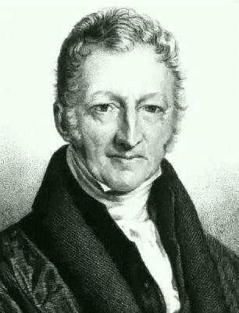
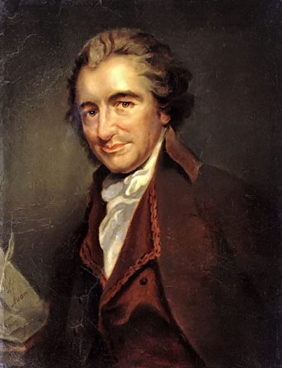
Two Highlighted Figures
Ch. 7-9
Thomas Paine
-Common Sense (1776)
-pamphlets The American Crisis (1776-83) → “These are the times that try men’s souls,”
-The Rights of Man (1791) → defense of French Revolution
-The Age of Reason (1795) → attack on organized religion (loved by Jeffersonians and loathed by Federalists)
-written from jail cell after banished from Britain for radical political expression
Thomas Malthus
-Essay on the Principle of Population (1798)
-warned “of an impending population explosion” and “predicted that the British population would soon outstrip the country’s food supply” → warned that it would spread to America
-Jefferson wasn’t worried and said that “the Malthusian prediction need not trouble the United States as long as country kept expanding

Slide 24
Questions Chapters 1-3
1. Which New World explorer is famous for falsifying his ship logs in order to make his expedition seem more favorable to royals and the people?
a. Columbus b. Magellan c. Pizarro
2. What cultural style during the Renaissance applied to aspects of society including architecture, art, and literature?
a. Neolithic b. Gothic c. Victorian
3. Who wrote the colonial novel “Briefe and True Report of the Newfound Land of Virginia “ in 1588 that “addressed mainly to the problem of identifying the ‘merchantable commodities’ that would support settlement, for without products a colonial system was impossible”
a. Thomas Harriot b. John Locke c. Bartolome de las Casas
4. Of what historical collapse did “Spanish Catholic priest” Bartolome de las Casas write about in his 1552 novel?
a. Christian raid of the Indies b. Fall of the Aztecs as by the Spanish
c. Columbus’ raid of the Native American territories
5. What did Thomas Harriot and John White “most accurately” describe in the later edition of the former’s “Briefe and True Report of the Newfound Land of Virginia” in 1588?
a. Cortez and his men invading the Aztec lands b. Columbus’ landing in the New World
c. The Europeans’ first “contact” with the Native Americans

Slide 25
Questions Chapters 1-3
6. What form of literature did the Native Americans use to share their stories (originally)?
a. Written b. Oral c. Musical
7. Which of these words is originally derived from a Native American word?
a. “potato” b. “butter” c. “paragraph”
8. What disease afflicted both the Europeans and the Native Americans, prompting many accounts (written and drawn) concerning their affects?
  a. Chicken pox b. Smallpox c. Syphilis
9. What is an example of a “totem” that the Native Americans used in their storytelling?
  Wolf b. Monkey c. Panda
10. Alvar Nunez Cabeza de Vaca was a castaway of what famous Florida explorer (de Vaca published an account of his time with this explorer)?
  a. Christopher Columbus b. Ferdinand Magellan c. Juan Ponce de Leon

Slide 26
Answers Chapters 1-3
1. A 6. B
2. B 7. A
3. A 8. B
4. A 9. A
5. C 10. C

Slide 27
Questions Chapters 4-6
1. Which of the following authors wrote “Sovereignty and Goodness of God”?
a. Mary Rowlandson b. Benjamin Franklin c. John Locke
2. When did the distribution of the Massachusetts Circular Letter begin?
a. September 1775 b. February 1768 c. June 1759
3. Which of the following men wrote “Poor Richard’s Almanac”?
  a. John Locke b. John Dickinson c. Benjamin Franklin
4. What act was Milcah Martha Moore encouraging readers to rebel against when she wrote her poetry while in the Daughters of Liberty?
  a. Tea Act b. The Great Awakening c. Revenue Acts
5. Daniel Dulany’s “Considerations on the Propriety of Imposing Taxes” was published during of what series of acts?
  a. Stamp Acts b. Revenue Acts c. Liberation Acts

Slide 28
Questions Chapters 4-6
6. Which of these novels were not sold during the Enlightenment era?
  a. “Moll Flanders” b. “Ivanhoe” c. “Tom Jones”
7. Approximately how many narrative novels did Mary Rowlandson inspire after her publication of “Sovereignty and Goodness of God”?
  a. 600 b. 700 c. 500
8. When was John Locke’s “Letter on Tolerance” published?
  a. 1800 b. 1688 c. 1679
9. Who wrote that “forced worship…stinks in God’s nostrils” in his 1644 novel “The Bloudy Tenet of Persecution”?
  a. Roger Williams b. Benjamin Franklin c. John Locke
10. “The Interesting Narrative of the Life of Olaudah Equiano” depicted the title character’s life as which of these?
  a. Plantation owner b. Slave c. Slave seller

Slide 29
Answers Chapters 4-6
1. A 6. B
2. B 7. C
3. C 8. B
4. A 9. A
5. A 10. B

Slide 30
Questions Chapters 7-9
1. Which of these Revolutionary Era authors wrote “Common Sense”?
a. Thomas Paine b. Thomas Malthus c. Thomas Jefferson
2. Parson Weems wrote about the life of which president that included a false anecdote about a cherry tree?
a. Thomas Jefferson b. John Adams c. George Washington
3. Who was the Pittsburgh Gazette Editor that also wrote the satirical novel “Modern Chivalry”?
a. Hugh Henry Brackenridge b. Noah Webster c. Thomas Malthus
4. What are the names of the two political parties that frequently voiced their separate opinions in various circulating newspapers, therefore affiliating the publications with the parties’ name(s)?
a. Federalists and Colonists b. Federalists and Democratic Republicans
c. Democratic Republicans and Colonists
5. “Essay on the Principle of Popualtion” ___________:
a. “predicted that the British population would soon outstrip the country’s food supply”
b. “was used as a guideline in the Revolutionary Era”
c. wasn’t part of the Revolutionary Era

Slide 31
Questions Chapters 7-9
6. How many weekly or semi-weekly newspapers were there in America by 1789?
a. 37 b. 92 c. 106
7. What percent of the New England population was literate in the late eighteenth century?
a. 100% b. 70% c. 90%
8. Which of these men did NOT help write “The Federalist”?
a. James Madison b. John Jay c. Thomas Paine
9. Which of the following is credited as the “first American novel”?
a. The Power of Sympathy b. Common Sense c. The Age of Reason
10. Which of the following is considered the “most famous African-American writer” of the Revolutionary Era?
a. Jupiter Hammon b. Phillis Wheatley c. Martin Luther King, Jr.

Slide 32
Answers Chapters 7-9
1. A 6. B
2. C 7. C
3. A 8. C
4. B 9. A
5. A 10. B

Slide 33
Sources (Information)
Book (textbook used in all chapters):
Faragher, J.M., Buble, M.J., Czitrom, D., & Armitage, S.H. (2002). Out of Many, A History of the American People. Upper Saddle River, N.J.: Prentice Hall.
Demos, J. (1991). “Husbands and Wives, Parents and Children in Puritan Society” from A Little Commonwealth: Family Life in Plymouth Colony. New York, N.Y.: Oxford Press.
Online:
Chapter 1-3:
Early American and Colonial Period. Retrieved September 5, 2010, from America Web site: http://www.america.gov
A Chronology of the Reign of King James II (1685-88) and The Glorious Revolution (1688-89). Retrieved September 5, 2010, from The Glorious Revolution Web site: http://www.thegloriousrevolution.org
Chapter 4-6:
Textbook – see earlier sources
Chapter 7-9:
The Articles of Confederation – Excerpts. Retrieved October 17, 2010, from DuLaw Web site: http://dulaw.net/

Slide 34
Sources (Images)
Background:
Patriotic Background. Retrieved October 17, 2010, from Wayne Township informational Web site: http://wayne-township.info
Title Slide Image:
US Flag American Literature 72 image. Retrieved October 17, 2010, from Wordpress Web site: http://joefelso.files.wordpress.com/
Chapter 1-3 Images:
Bartolome De Las Casas. Retrieved October 17, 2010, Google Images, http://sicsemanal.files.wordpress.com/2007/06/bartolome.jpg
Thomas Harriot. Retrieved October 17, 2010, Google Images http://www.rensoc.org.uk/ths/HarriotR.jpg
Native Picture. Retrieved October 17, 2010, Google Images, http://www.shannonthunderbird.com/nativepic.gif

Slide 35
Sources (Images)
Chapter 4-6 Images:
Benjamin Franklin. Retrieved October 17, 2010, Google Images, http://www.elcivics.com/images/benjamin-franklin.jpg
John Locke. Retrieved October 17, 2010, Google Images, http://charlottehutson.files.wordpress.com/2009/08/locke.jpg
Chapter 7-9 Images:
Thomas Malthus. Retrieved October 17, 2010, Google Images, http://www.nndb.com/people/250/000024178/malthus.jpg
Thomas Paine. Retrieved October 17, 2010, Google Images, http://blog.syracuse.com/news/2009/08/thomas_paine1.jpg

